Slide 1
NEURAL NETWORKS AND DEEP LEARNING
Submitted by:
MAYANK CHOUDHARY
Roll. No. 35515002818
Serial no. 57 ECE-1

Slide 2
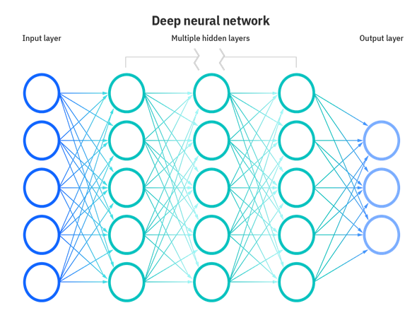
What are neural networks?
Neural networks, also known as artificial neural networks (ANNs) or simulated neural net-works (SNNs), are a subset of machine learning and are at the heart of deep learn-ing algorithms. Their name and structure are inspired by the human brain, mimicking the way that biological neurons signal to one another. Artificial neural networks (ANNs) are comprised of a node layers, containing an input layer, one or more hidden layers, and an output layer. Each node, or artificial neuron, connects to another and has an associated weight and threshold. If the output of any individual node is above the specified threshold value, that node is activated, sending data to the next layer of the network. Otherwise, no data is passed along to the next layer of the net-work.

Slide 3
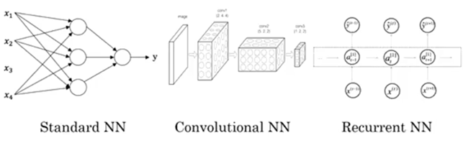
Different types of Neural Networks in Deep Learning
Artificial Neural Networks (ANN)
Convolution Neural Networks (CNN)
Recurrent Neural Networks (RNN)

Slide 4
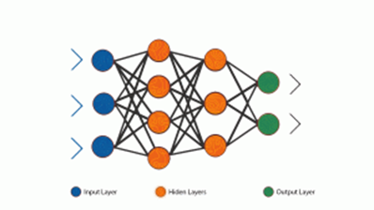
Standard/Artificial Neural Network (ANN)
A single perceptron (or neuron) can be imagined as a Logistic Regression. Artificial Neural Network, or ANN, is a group of multiple perceptrons/ neurons at each layer. ANN is also known as a Feed-Forward Neural network because inputs are processed only in the forward direction:

Slide 5
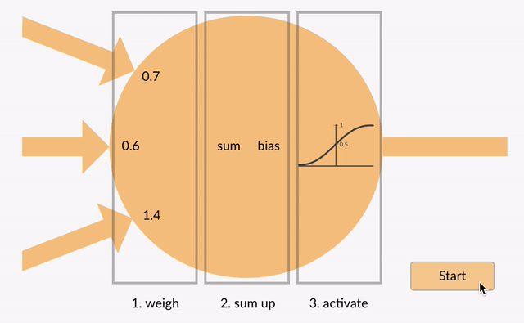
Artificial Neural Network is capable of learning any nonlinear function. Hence, these networks are popularly known as Universal Function Approximators. ANNs have the capacity to learn weights that map any input to the output. One of the main reasons behind universal approximation is the activation function. Activation functions introduce nonlinear properties to the network. This helps the network learn any complex relationship between input and output.

Slide 6
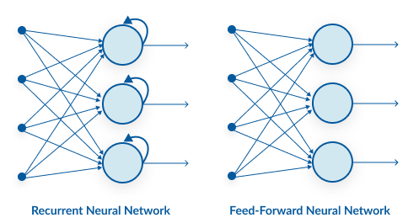
Recurrent Neural Network (RNN)
A looping constraint on the hidden layer of ANN turns to RNN. • RNN captures the sequential information present in the input data i.e. dependency be-tween the words in the text while making predictions:
• RNNs share the parameters across different time steps. This is popularly known as Parameter Sharing. This results in fewer parameters to train and decreases the computational cost

Slide 7
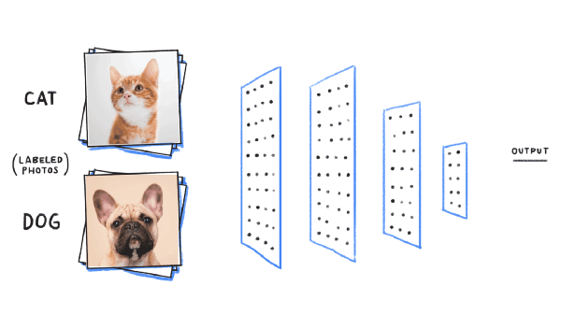
Convolution Neural Network (CNN)
Convolutional neural networks (CNN) are all the rage in the deep learning community right now. These CNN models are being used across different applications and domains, and they’re especially prevalent in image and video processing projects.
• CNN learns the filters automatically without mentioning it explicitly. These filters help in extracting the right and relevant features from the input data. • CNN captures the spatial features from an image. Spatial features refer to the ar-rangement of pixels and the relationship between them in an image. They help us in identifying the object accurately, the location of an object, as well as its relation with other objects in an image.

Slide 8
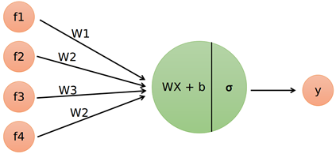

Logistic Regression as a Neural Network
Logistic regression is a binary classification method. It can be modelled as a function that can take in any number of inputs and constrain the output to be between 0 and 1. This means, we can think of Logistic Regression as a one-layer neural network. For a binary output, if the true label is y (y = 0 or y = 1) and y_hat is the predicted output – then y_hat represents the probability that y = 1 - given inputs w and x. Therefore, the probability that y = 0 given inputs w and x is (1 - y_hat), as shown below.

Slide 9
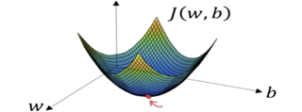
What is a Gradient?
A gradient measures how much the output of a function changes if you change the inputs a little bit It simply measures the change in all weights with regard to the change in error. You can also think of a gradient as the slope of a function. The higher the gradient, the steeper the slope and the faster a model can learn. But if the slope is zero, the model stops learning. Said it more mathematically, a gradient is a partial derivative with respect to its inputs.

Slide 10
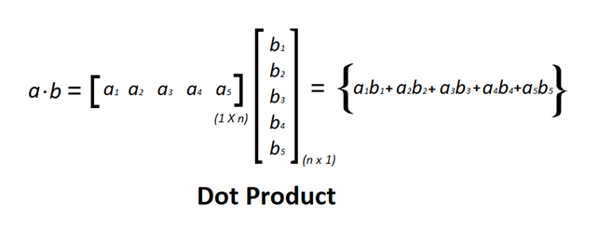
What is Vectorization ?
Vectorization is used to speed up the Python code without using loop. Using such a function can help in minimizing the running time of code efficiently. Various operations are being performed over vector such as dot product of vectors which is also known as scalar product as it produces single output, outer products which results in square matrix of dimension equal to length X length of the vectors, Element wise multiplication which products the element of same indexes and dimension of the matrix remain unchanged.

Slide 11
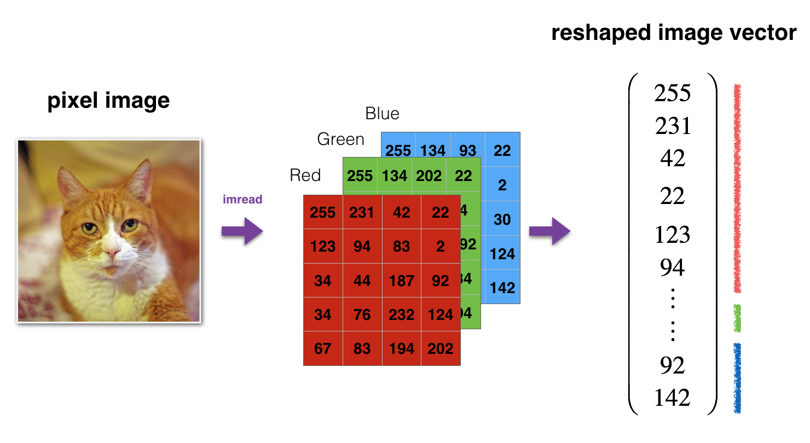
Deep Neural Network for Image Classification: Application
We reshape and standardize the images before feeding them to the network. The code is given in the cell below.
Image to vector conversion

Slide 12
Packages
Let's first import all the packages that you will need during this assignment.
numpy is the fundamental package for scientific computing with Python.
matplotlib is a library to plot graphs in Python.
h5py is a common package to interact with a dataset that is stored on an H5 file.
PIL and scipy are used here to test your model with your own picture at the end.
dnn_app_utils provides the functions implemented in the "Building your Deep Neural Network: Step by Step" assignment to this notebook.
np.random.seed(1) is used to keep all the random function calls consistent. It will help us grade your work.

Slide 13
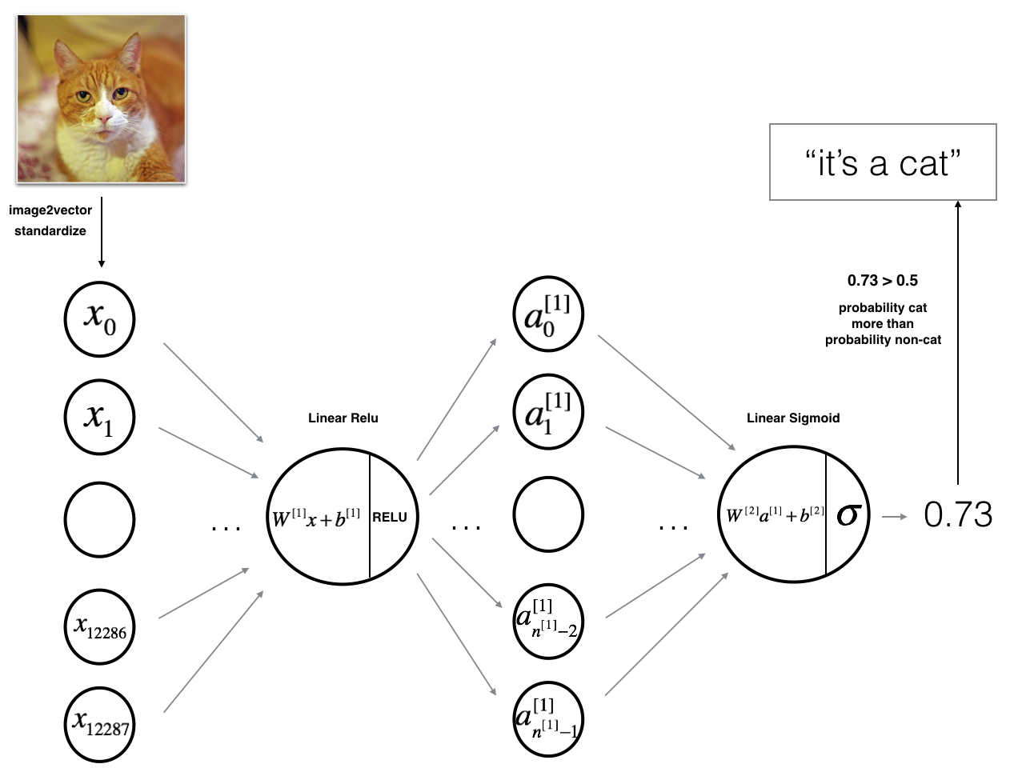
2-layer deep neural network
We will build a Deep neural network to distinguish cat images from non-cat images. However, here is a simplified network representation:
The input is a (64,64,3) image which is flattened to a vector of size (12288,1)(12288,1).
The corresponding vector: [x0,x1,...,x12287]T[x0,x1,...,x12287]T is then multiplied by the weight matrix W[1]W[1] of size (n[1],12288)(n[1],12288).
You then add a bias term and take its relu to get the following vector: [a[1]0,a[1]1,...,a[1]n[1]−1]T[a0[1],a1[1],...,an[1]−1[1]]T.
You then repeat the same process.

Slide 14
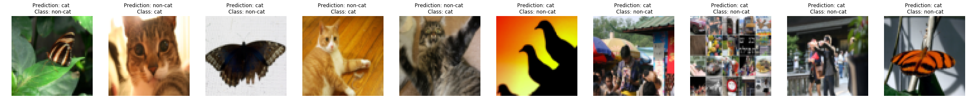
Results Analysis
First, let's take a look at some images the L-layer model labeled incorrectly. This will show a few mislabeled images.
A few types of images the model tends to do poorly on include:
Cat body in an unusual position
Cat appears against a background of a similar color
Unusual cat color and species
Camera Angle
Brightness of the picture
Scale variation (cat is very large or small in image)

Slide 15



Biblography
Coursera: The course is offered by DeepLearning.AI
Wikipedia
Google images

Slide 16
THANK YOU

